Slide 1
هوش محاسباتی:
منطق فازی
دانشكده مهندسي كامپيوتر
دانشگاه علم و صنعت ايران
ناصر مزيني mozayani@iust.ac.ir
مقدمه

Slide 2
About !?
Computational Intelligence
  ANN
  GA
  Fuzzy logic
  …

Slide 3
A bit of history
Let back to Greek history
  Aristotle (294 to 322 BC) father of logic who developed axioms :
    Law of noncontradiction
    Law of the excluded middle
  According to above laws an apple is either an apple or not an apple, but not both at the same time

Slide 4
History (contd.)
Laws hold for objects with precise definitions, all mathematical methodology
Not for our real world : 190cm is tall and 189.99 would not be considered as so ?!

Slide 5
History (contd.)
Moving to the 20th Century :
  Bertrand Russell, paper on vagueness in 1923
    “Vagueness clearly is a matter of degree”
    Intrinsic fuzziness
  Heisenberg’s uncertainty principle ppt
    speed or position ?
    (There are local truths, not global truths)
  Schroedinger’s cat (1935) ppt
  Black’s concept of vagueness (1937)
  Einstein (1937)
    “As far as the laws of mathematics refer to reality, they are not certain, and as far as they are certain, they do not refer to reality”

Slide 6
History (contd.)
Fuzzy logic invention:
  Lotfi zadeh (1965), although the ideas can be traced back to earlier works (1962…)
  Zadeh (1968), fuzzy algorithms
  Zadeh (1970), fuzzy decision making
  Zadeh (1973), fuzzy control

Slide 7
History (contd.)
Fuzzy follow up:
  Mamdani, first practical demonstration (1975 )
  First fuzzy controller, Holmblad 1978
  First commercial applications in 1981
  In 1994, Japan exported products worth $35 billion that use fuzzy logic !

Slide 8
Some good points
Knowledge + data mining
  “combining human knowledge with other knowledge that only a machine can uncover”
Neither a statistical nor a mathematical modeling technology
Computing with words rather than numbers
Can cope with chaotic and non-linear systems
A big business appearing to work well !!

Slide 9
What does it mean ?
Logic
  Science of reasoning that describes relationships among propositions in terms of implication, contradiction, etc.
  More formally knows as Boolean, Bivalent or Binary logic
Fuzzy
  Linguistically denotes vagueness, imprecision, uncertainty
  Mathematically means multivalued or multivalent
Fuzzy logic:
Multivalued logic system that can be used
to represent imprecision

Slide 10
Bivalent vs. Fuzzy logic
Bivalent
  Objects either belongs to a set or they don’t
  Characteristic function that maps the universe as a set of two elements, i.e. 0 or 1
Fuzzy logic
  The notion of membership in a set is modified such that objects can now have partial membership in a set
  Characteristic function that maps the universe as ”a continuum [0,1]”

Slide 11
Fuzzy Set Theory
Handle situations with no sharp boundaries
  “it’s a warm day”, “he is young”, “that’s a good result”
Two kind of fuzziness :
  Intrinsic fuzziness
    “tall men” (tall is fuzzy and depends to the context, observer, culture…)
  Informational fuzziness
    “creditworthy customers” (they can possibly be described completely and crisply with a large number of descriptors
  WARNING !
    There is nothing fuzzy about fuzzy set theory !

Slide 12
Fuzzy Set Theory
Handle situations with no sharp boundaries
  “it’s a warm day”, “he is young”
1.0
0.8
0.6
Middle-
Aged
Young
Old
0.4
0.2
0.0
20
40
60
80
100

Slide 13
Fuzzy mathematics
The formal framework of the theory of fuzzy sets

Slide 14
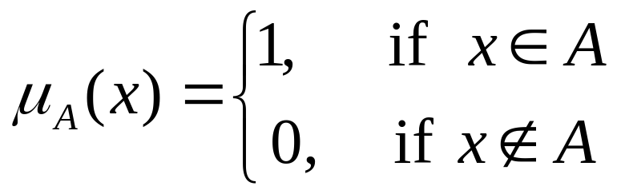
Set Theory review
A classical (crisp) set is defined as a collection of elements:
  Enumeration (list) method: A={2,4,6,8}
  Rule method (analytically) : A={x I x<10}
  Membership method :

Slide 15
Set Theory review
Universe
A
Not A
Complement
Intersection
Union
A
B
Suppose A ={x ∈ A | x<5}
If x=4 then x ∈ A……… ⇒ TRUE or 1
If x=8 then x ∉ A……… ⇒ FALSE or 0

Slide 16
Fuzzy Set
Characteristic function allows various degrees of membership :
  A fuzzy set Ã in X is a set of ordered pairs:
  Ã={(x,μ_{Ã}(x)) |x∈X}
Different ways of denoting fuzzy sets:
  Ordered set of pairs
  Only by stating MBF
  Integral method

Slide 17
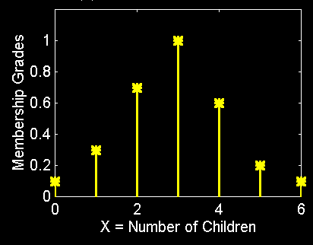
Fuzzy Set with Discrete Universes
Fuzzy set C = “desirable city to live in”
    X = {SF, Boston, LA} (discrete and non-ordered)
    C = {(SF, 0.9), (Boston, 0.8), (LA, 0.6)}
    (subjective membership values!)
  Fuzzy set A = “sensible number of children”
    X = {0, 1, 2, 3, 4, 5, 6} (discrete universe)
    A = {(0, .1), (1, .3), (2, .7),
    (3, 1), (4, .6), (5, .2), (6, .1)}
    (subjective membership
    values!)

Slide 18
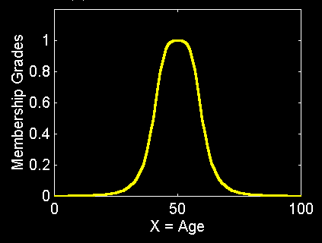
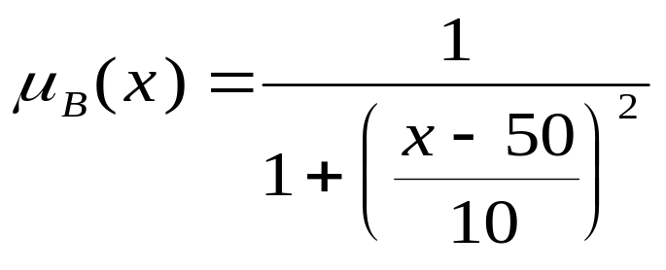
Fuzzy Sets with Cont. Universes
Fuzzy set B = “about 50 years old”
    X = Set of positive real numbers (continuous)
    B = {(x, μB(x)) | x in X}

Slide 19
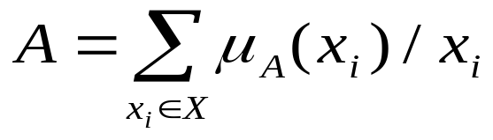
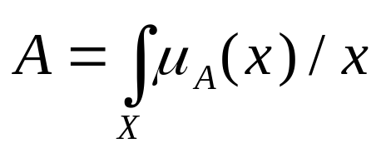
Alternative Notation
  A fuzzy set A can be alternatively denoted as follows:
X is discrete
X is continuous
Note that Σ and integral signs stand for the union of membership grades; “/” stands for a marker and does not imply division.

Slide 20
Some definitions
Support Ã
α-level or α-cut
  Strong α-level
Convexity
Cardinality or power
  Relative cardinality
Intersection
Union
complement

Slide 21
Some definitions
  Support(A) = {x ∈ X | μ_{A}(x) > 0}
  Core(A) = {x ∈ X | μ_{A}(x) = 1}
  Normality: core(A) ≠ ∅ ⇒ A is a normal fuzzy set
  Crossover(A) = {x ∈ X | μ_{A}(x) = 0.5}
  α - cut: A_{α} = {x ∈ X | μ_{A}(x) ≥ α}
  Strong α - cut: A’_{α} = {x ∈ X | μ_{A}(x) > α}

Slide 22
MF
1
.5
α
0
Core
X
Crossover points
α - cut
Support

Slide 23
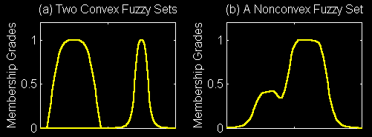
Convexity of Fuzzy Sets
A fuzzy set A is convex if for any λ in [0, 1],

Slide 24
Complement
      General requirements:
        Boundary: N(0)=1 and N(1) = 0
        Monotonicity: N(a) > N(b) if a < b
        Involution: N(N(a)) = a

Slide 25
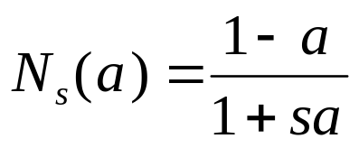

      Two types of fuzzy complements:
        Sugeno’s complement:
        (Family of fuzzy complement operators)
        Yager’s complement:
(s > -1)
(w > 0)

Slide 26
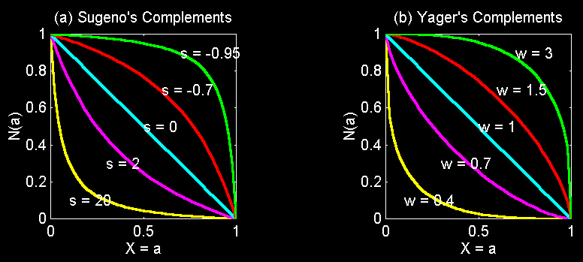
Sugeno’s complement:
Yager’s complement:

Slide 27
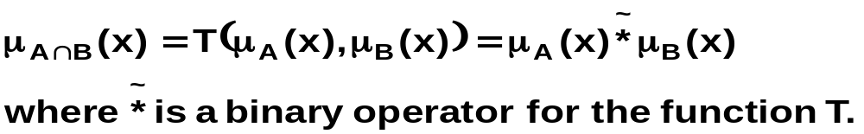
  Fuzzy Intersection and Union:
    The intersection of two fuzzy sets A and B is specified in general by a function
    T: [0,1] * [0,1] → [0,1] with
    This class of fuzzy intersection operators are called T-norm (triangular) operators.

Slide 28
    T-norm operators satisfy:
        Boundary: T(0, 0) = 0, T(a, 1) = T(1, a) = a
        Correct generalization to crisp sets
        Monotonicity: T(a, b) < T(c, d) if a < c and b < d
        A decrease of membership in A & B cannot increase a membership in A ∩ B
        Commutativity: T(a, b) = T(b, a)
        T is indifferent to the order of fuzzy sets to be combined
        Associativity: T(a, T(b, c)) = T(T(a, b), c)
        Intersection is independent of the order of pairwise groupings

Slide 29
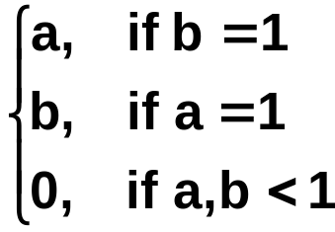
    T-norm (cont.)
      Four examples :
        Minimum: Tm(a, b) = min (a,b) = a ∧ b
        Algebraic product: Ta(a, b) = ab
        Bounded product: Tb(a, b) = 0 V (a + b – 1)
        Drastic product: Td(a, b) =

Slide 30
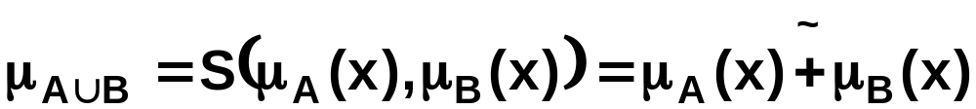
    T-conorm or S-norm
    The fuzzy union operator is defined by a function
    S: [0,1] * [0,1] → [0,1]
    wich aggregates two membership function as:
    where s is called an s-norm satisfying:
        Boundary: S(1, 1) = 1, S(a, 0) = S(0, a) = a
        Monotonicity: S(a, b) < S(c, d) if a < c and b < d
        Commutativity: S(a, b) = S(b, a)
        Associativity: S(a, S(b, c)) = S(S(a, b), c)

Slide 31
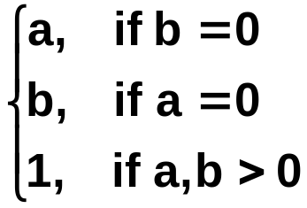
    T-conorm or S-norm (cont.)
      Four examples :
        Maximum: Sm(a, b) = max(a,b) = a V b
        Algebraic sum: Sa(a, b) = a + b - ab
        Bounded sum: Sb(a, b) = 1 ∧ (a + b)
        Drastic sum: Sd(a, b) =

Slide 32
    Generalized DeMorgan’s Law
      T-norms and T-conorms are duals which support the generalization of DeMorgan’s law:
        T(a, b) = N(S(N(a), N(b)))
        S(a, b) = N(T(N(a), N(b)))
Tm(a, b)
Ta(a, b)
Tb(a, b)
Td(a, b)
Sm(a, b)
Sa(a, b)
Sb(a, b)
Sd(a, b)

Slide 33
  Parameterized T-norm and T-conorm
    Parameterized T-norms and dual T-conorms have been proposed by several researchers:
      Yager
      Schweizer and Sklar
      Dubois and Prade
      Hamacher
      Frank
      Sugeno
      Dombi

